Slide 1
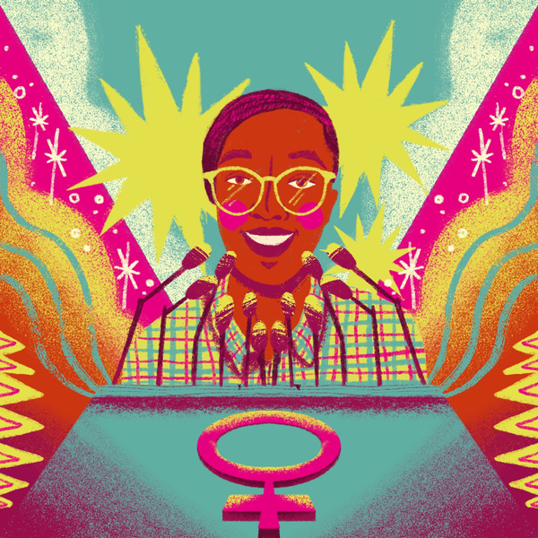
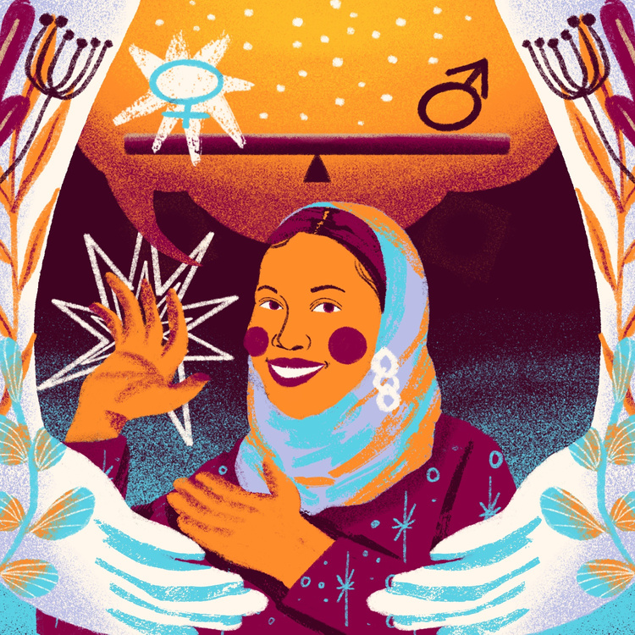
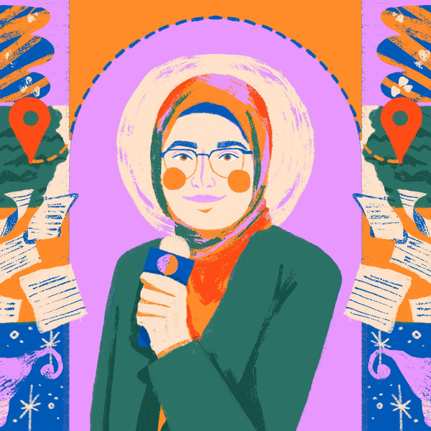
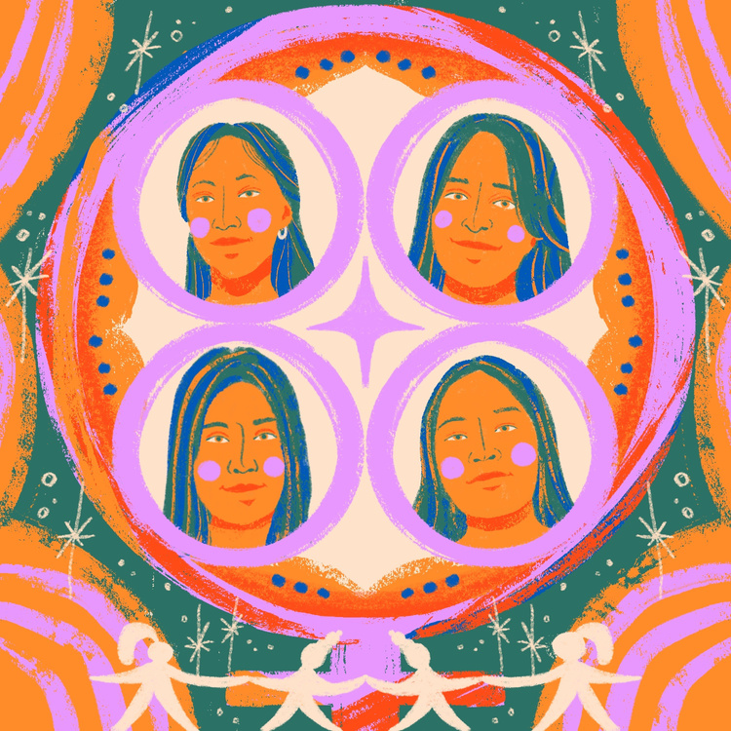
Learn how you can take action to support girls Turning The World Around
International Day of the Girl 2023
Youth Toolkit
Do not share externally before the 3d of October 2023

Slide 2
Turning The World Around
Injustice is driving girls to act. Whether it’s the climate crisis, or gender discrimination, they’re refusing to stay silent. Girls are speaking up. They’re getting things done, and creating lasting change – in their communities, at a national level, and globally. But being a girl activist can be tough and unrelenting. ​
In Plan International’s new State of the World’s Girl Report 2023 - Turning the world around: Girl and young women activists leading the fight for equality - we’ve spoken to over a thousand girl and young women activists from 26 countries around the world. Girl activists face countless risks, whether it’s hostility from community members, oppressive policing or online abuse. One in five (17%) of girl and young women activists have feared for their safety while carrying out their work. For many girls and young women, access to funding and policy makers is in short supply, adding to the struggle to get their voices heard. The single biggest barrier to girls’ activism is a shortage of funding. More than half (54%) of girls we surveyed named a lack of finances as the main factor holding their campaigning back.
​
This #DayoftheGirl2023, Plan International is standing with girl activists, and with your support the Girls Get Equal campaign is calling on governments, donors and civil society for accountability and resourcing to girl and youth activists. ​
​
​

Slide 3
This International Day of the Girl Plan International demands...

Slide 4
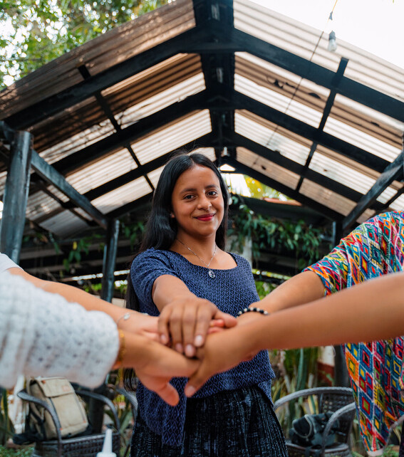
but what can you do to help?
We’ve gathered a few ideas to inspire your activism and help the girls who are Turning The World Around

Slide 5
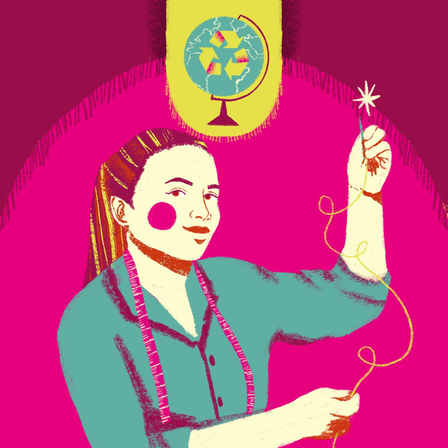
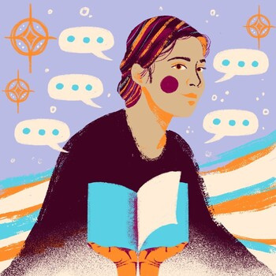
Heydi, Lesly, Yoselin, Vidalia, Guatemala​
Oilean, 23, Ireland​​
Rahimat, 18, Nepal​
1
​
This IDG, help us celebrate the power of girls and young women by sharing the stories and demands of some of the fantastic activists we work with.​ Hear more about their stories. Share their portraits by @nadya.noor online using the hashtag #GirlsGetEqual.
​
Soumya, 23, Somalia​
Blessing, 17, Sierra Leone​
Fatima, 21, Lebanon​

Slide 6
Want to promote the State of the World Girls through social media? Here are some messages for each platform.
Exciting news! Our new report explores what it’s like to be a young female activist in 2023. Over a thousand have shared their experiences, whether they feel safe and their motivations. Read more #DayOfTheGirl.
Our State of the World’s Girls Report is out now. It looks at the barrier's girl and young women activists face and the motivation and inspiration that drives them forward #DayOfTheGirl.
Our eye-opening new report explores what it’s like to be an adolescent girl or young woman activist in 2023. We found that 17% have feared for their safety while carrying out their work. Despite this, nearly all say campaigning has had a positive impact on their lives. Read more #DayOfTheGirl.
Girl activists around the 🌎 are speaking up on issues that are important to them and changing their communities for the better. But being a girl activist is not easy. All too often they are ignored, or worse, harassed or ostracised. This #DayOfTheGirl, we stand with girls and young women as they call for powerholders to play their part in supporting girl activists to create a better world. This is what they want to see . (Insert the 4 report recommendation graphics as a carousel)
2
This #IDG2023, we’re standing with girls and young women activists as they share stories around the barriers they face, and what motivates them to keep going. Here are their recommendations for how we can all support girl-led activism #GirlsGetEqual. (Insert the 4 report recommendation graphics as a carousel.)
Exciting news! Our new report explores what it’s like to be an adolescent girl or young woman activist in 2023. It found that #GenderEquality is the single most important issue for them. For more on their recommendations and how we can support them to create a better world, see 👇.
#IDG2023 #DayOfTheGirl #InternationalDayOfTheGirl #GirlsGetEqual

Slide 7
Unleash your creativity! engage your networks around IDG
Here’s some initial ideas proposed by our Global Young Influencer Group to get you started
1. Host an art challenge: Ask young people in your network to create art based on the theme of Girls’ Activism Accountability and Resourcing.
2. Host a youth webinar, explaining the theme to your peers, and sharing the findings of the report.
3. Organise a podcast, sharing and discussing statistics from the State of The World Report
4. Host a social mixer/networking event with organizations working on girls’ activism. Share the report during the event and ask them to come up with one commitment on how to support Girls’ Activism Accountability and Resourcing.
5. Share this toolkit with your friends and networks
Inspired? Contact your local office of Plan International to let them know about the action you are organising or email us directly at girlsgetequal@plan-international.org
3

Slide 8
Inclusion checklist
SAFETY CHECKLIST
❑ Always check with your local office of Plan International before organizing an external-facing action.
❑ Always think of potential risks around the action you’re taking. If a risk is major and has a high probability to happen, then think of how you can modify the action.
❑ Never take an action that involves illegal activity or could put you at risk of arrest.
❑ Never use your full name when publicly speaking. Think of how you can protect your identity and privacy.
❑ Always think of how you can ensure the safety of everyone taking part in your event/action (i.e. never share their pictures, full names, and contact details without permission)
❑ Your physical and mental health always comes first! Don’t hesitate to take breaks from your activism and reach out for support if you need
❑ Who is this activity aiming to reach - and who else could we
include?
❑ What could stop somebody getting involved in this? How could we include them?
❑ Did you take any action to identify any individuals from nondominant groups, such as those with disabilities, LGBTIQA+ youth, ethnic/racial minority youth and include their needs in your risk assessment?
❑ How does this activity connect with the lives of the communities we want to include - what could we do to make it more relevant to a broader group of people?
❑ Do our communications channels reach the communities we want to engage - what other channels could we use to draw in a wider group?
❑ Is the space and language accessible and welcoming?

Slide 9
about
The Girls Get Equal campaign ​
Plan International has been campaigning for girls’ rights for over a decade. The Girls Get Equal campaign, created with youth activists around the world, aims to ensure girls and young women have equal power over their own lives and can shape the world around them. Girls and young women, in all their diversity, must be free to be themselves: to campaign, take collective action, and make decisions about the issues that affect their lives, wherever they are.
Plan International
Plan International is an independent development and humanitarian organisation that advances children’s rights and equality for girls. We strive for a just world, working together with children, young people, our supporters and partners

