Slide 1
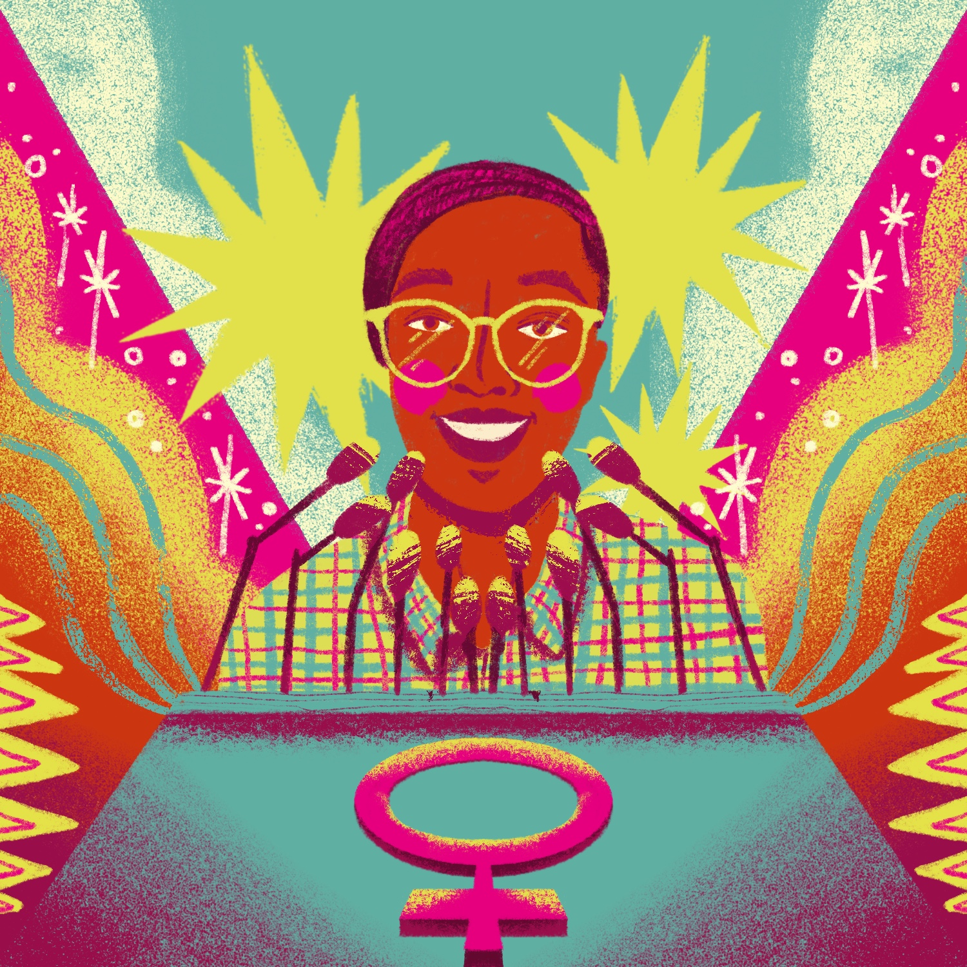
Action Toolkit
2
INTERNATIONAL
0
DAY OF THE
GIRL
2
3
Turning the World Around:
girls and young women activists leading the fight for equality
EMBARGO: 3 OCTOBER 2023, 20:00 BST

Slide 2
Turning The World Around
Injustice is driving girls to act. Whether it’s the climate crisis, or gender discrimination, they’re refusing to stay silent. Girls are speaking up. They’re getting things done, and creating lasting change – in their communities, at a national level, and globally. But being a girl activist can be tough and unrelenting.
In Plan International’s new State of the World’s Girl Report 2023 - Turning the world around: Girl and young women activists leading the fight for equality - we’ve spoken to over a thousand girl and young women activists from 26 countries around the world. Girl activists face countless risks, whether it’s hostility from community members, oppressive policing or online abuse. One in five (17%) of girl and young women activists have feared for their safety while carrying out their work. For many girls and young women, access to funding and policy makers is in short supply, adding to the struggle to get their voices heard. The single biggest barrier to girls’ activism is a shortage of funding. More than half (54%) of girls we surveyed named a lack of finances as the main factor holding their campaigning back.
This #DayOfTheGirl, Plan International is standing with girl activists, and with your support the Girls Get Equal campaign is calling on governments, donors and civil society for accountability and resourcing to girl and youth activists.

Slide 3
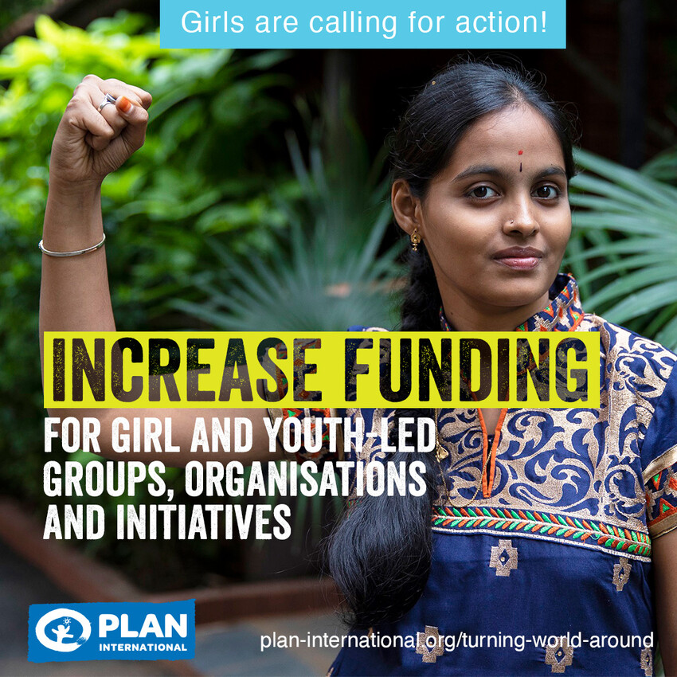
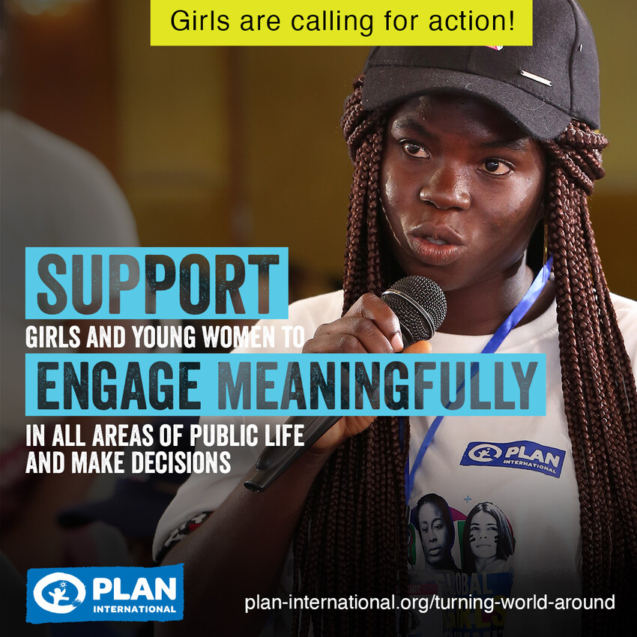
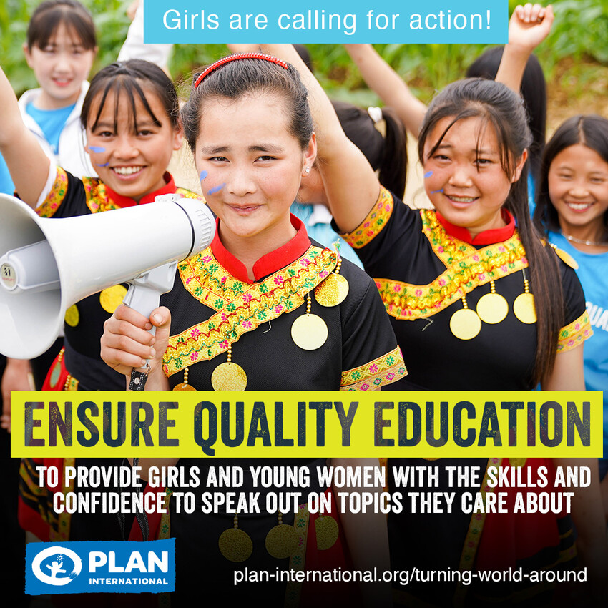
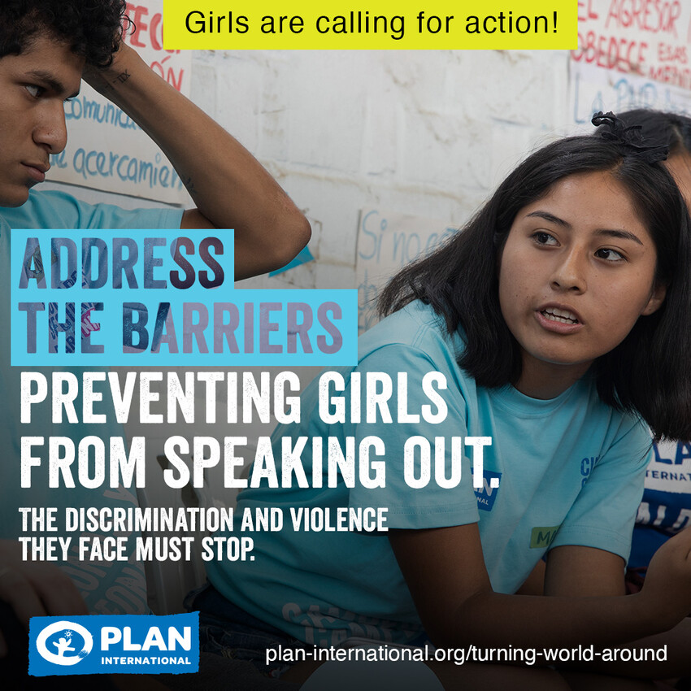
What Plan International is calling for this IDG
From Plan International’s new global research: “Turning the World Around: girls and young women activists leading the fight for equality”.
To support girl activists, we’re calling for governments, donors and civil society to:

Slide 4
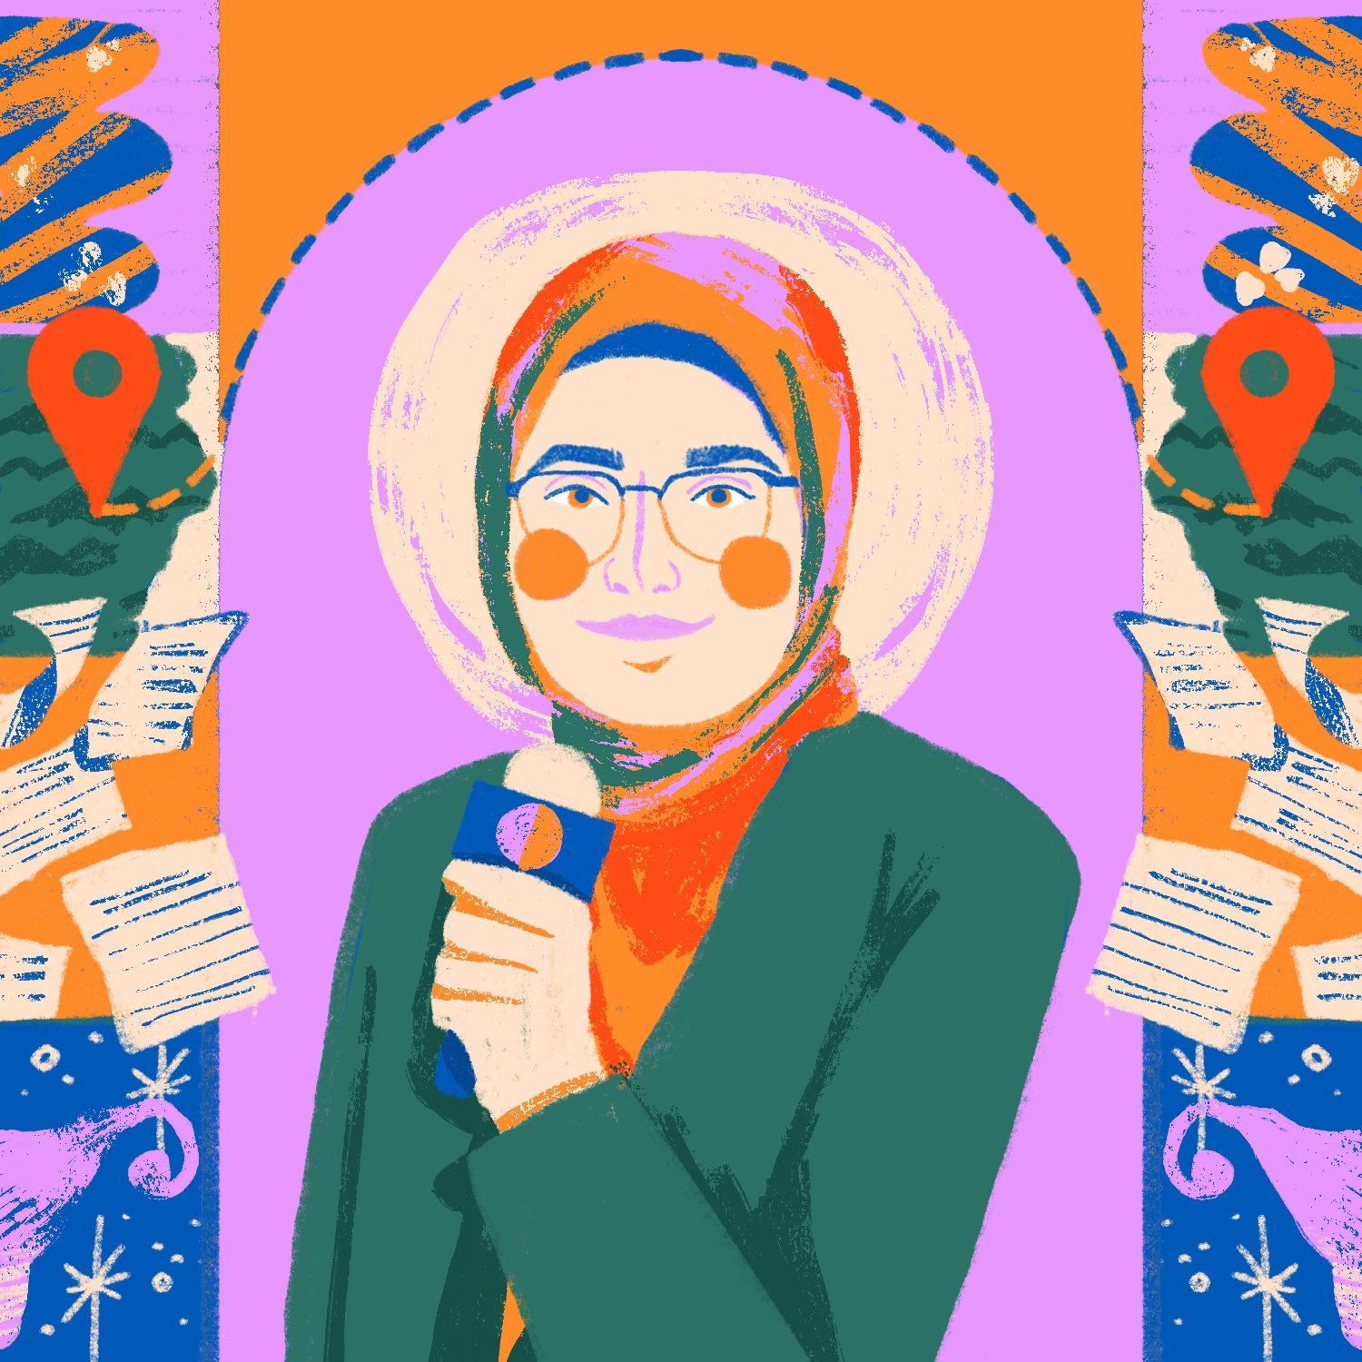
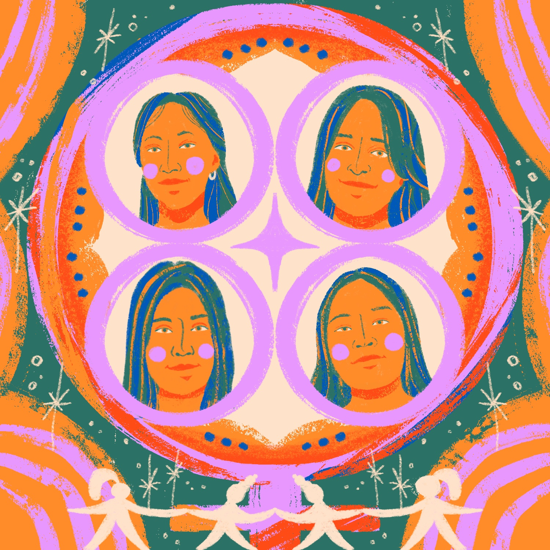
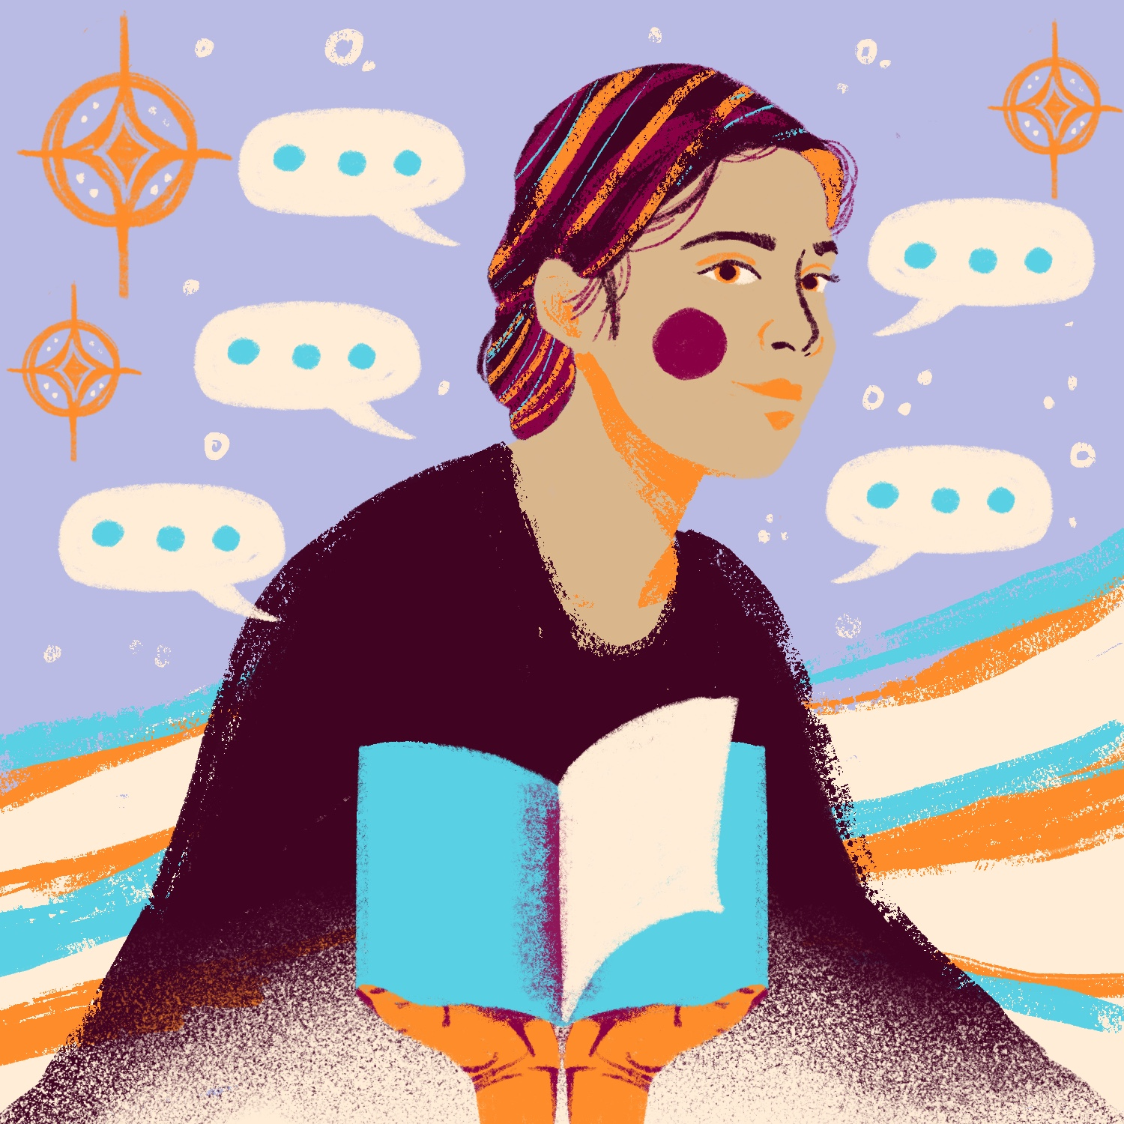
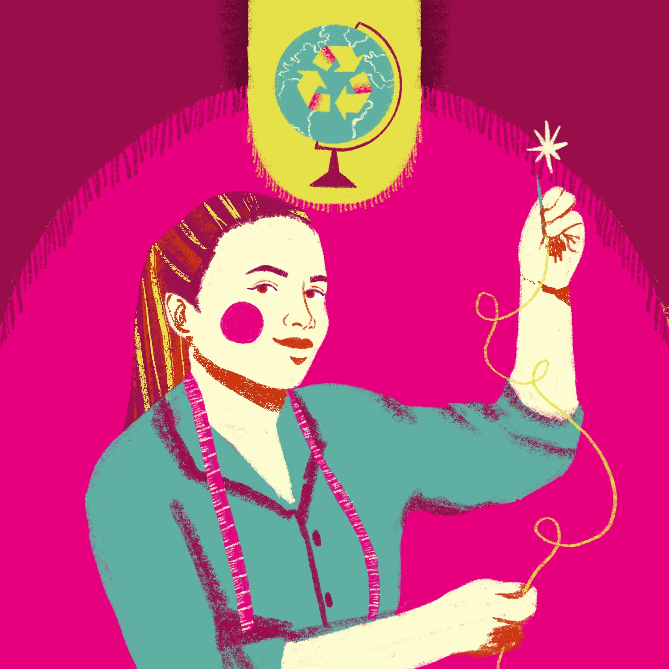
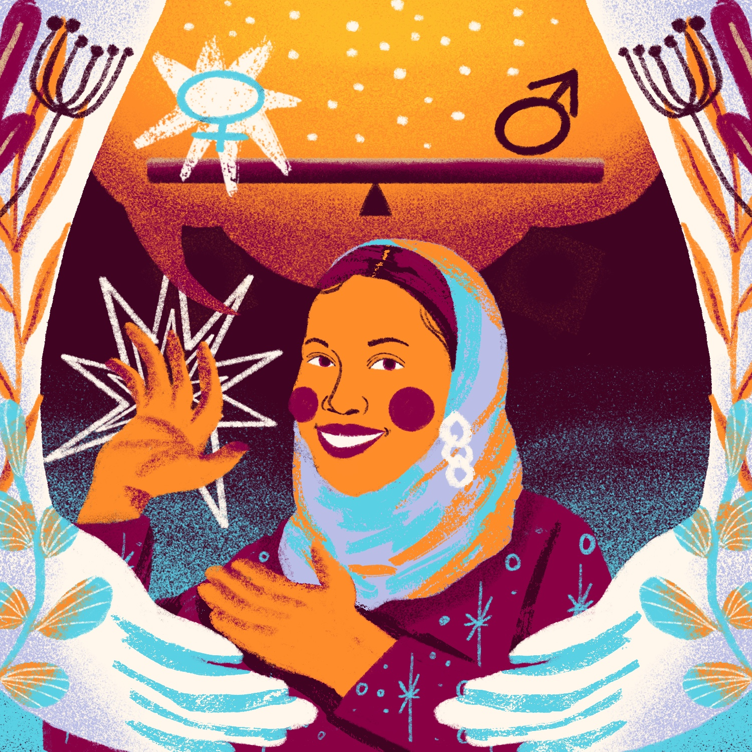
WORK WITH US!
This IDG 2023, help us celebrate the power of girls and young women by sharing the stories and demands of some of the fantastic activists we work with.
Blessing, 17, Sierra Leone
Fatima, 21, Lebanon
Heydi, Lesly, Yoselin, Vidalia, Guatemala
See their full stories here.
Share their portraits by @nadya.noor online.
Embargo: 3 OCTOBER 2023, 20:00 BST
Rahimat, 18, Nepal
Oilean, 23, Ireland
Soumya, 23, Somalia
Notes:
Blessing in Sierra Leone, who is campaigning for women’s representation in politics. Blessing shares her experience of success working as part of a campaign to change the law in Uganda to ensure representation for women in politics.
Rahimat in Nepal who campaigns against child marriage and human trafficking and for improved digital literacy for girls. Despite hostility and criticism, she continues to push for girl's rights.
Fatima in Lebanon campaigns for gender equality and sexual and reproductive health rights. Sharing her personal experience of the barriers she faced and how this shaped her journey to activism.
Oilean in Ireland is a climate change activist who has created a powerful movement in her community to engage people to consider their carbon footprint when buying clothes.
Soumaya in Somaliland campaigns for equal employment opportunities for girls and has used her drive and entrepreneurial skills to create a dedicated space for girls and young women to improve their access to employment.
The Guatemalan Girls Empowerment Movement are a group who campaign against gender-based violence and representatives Heydi (18 years old), Vidalía (19 years old), Lesley (19 years old), and Jocelin (14 years old) share how joining together has enabled them each to feel more confident to advocate for themselves and their peers as they flight for change.

Slide 5
Sample posts
Take action to spotlight Girl’s Activism, call for accountability and resourcing, and encourage others too! Share these posts on social media (embargoed until 3 October 2023, 20:00 BST)
See here for more examples on how you can get involved this IDG!
Exciting news! 📚 @PlanGlobal's new State of the World's Girls Report explores what it’s like to be a young female activist in 2023. Over a thousand have shared their experiences, whether they feel safe and their
motivations. Read more #DayOfTheGirl https://plan-international.org/publications/turning-the-world-around/
95% of the young female activists @‌planglobal spoke to said activism has had a positive impact on them. That’s why it’s critical that we all play our part in supporting their work. #DayOfTheGirl https://plan-international.org/publications/turning-the-world-around/
Meet Fatima 👋🏽 A strong advocate for #GenderEquality in her community. She believes that girls in Lebanon shouldn’t be scared to understand and talk about their sexual health and reproductive rights. This #IDG2023, we’re celebrating activists like Fatima 🙌. Insert Fatima illustration
This #IDG2023, we’re standing with youth activists like Blessing from Sierra Leone who is empowering girls and young women in her community to become leaders 🌟. Hear from her as she shares more on the challenges of being an activist and what motivates her to keep going #DayOfTheGirl. Insert Blessing portrait video

Slide 6
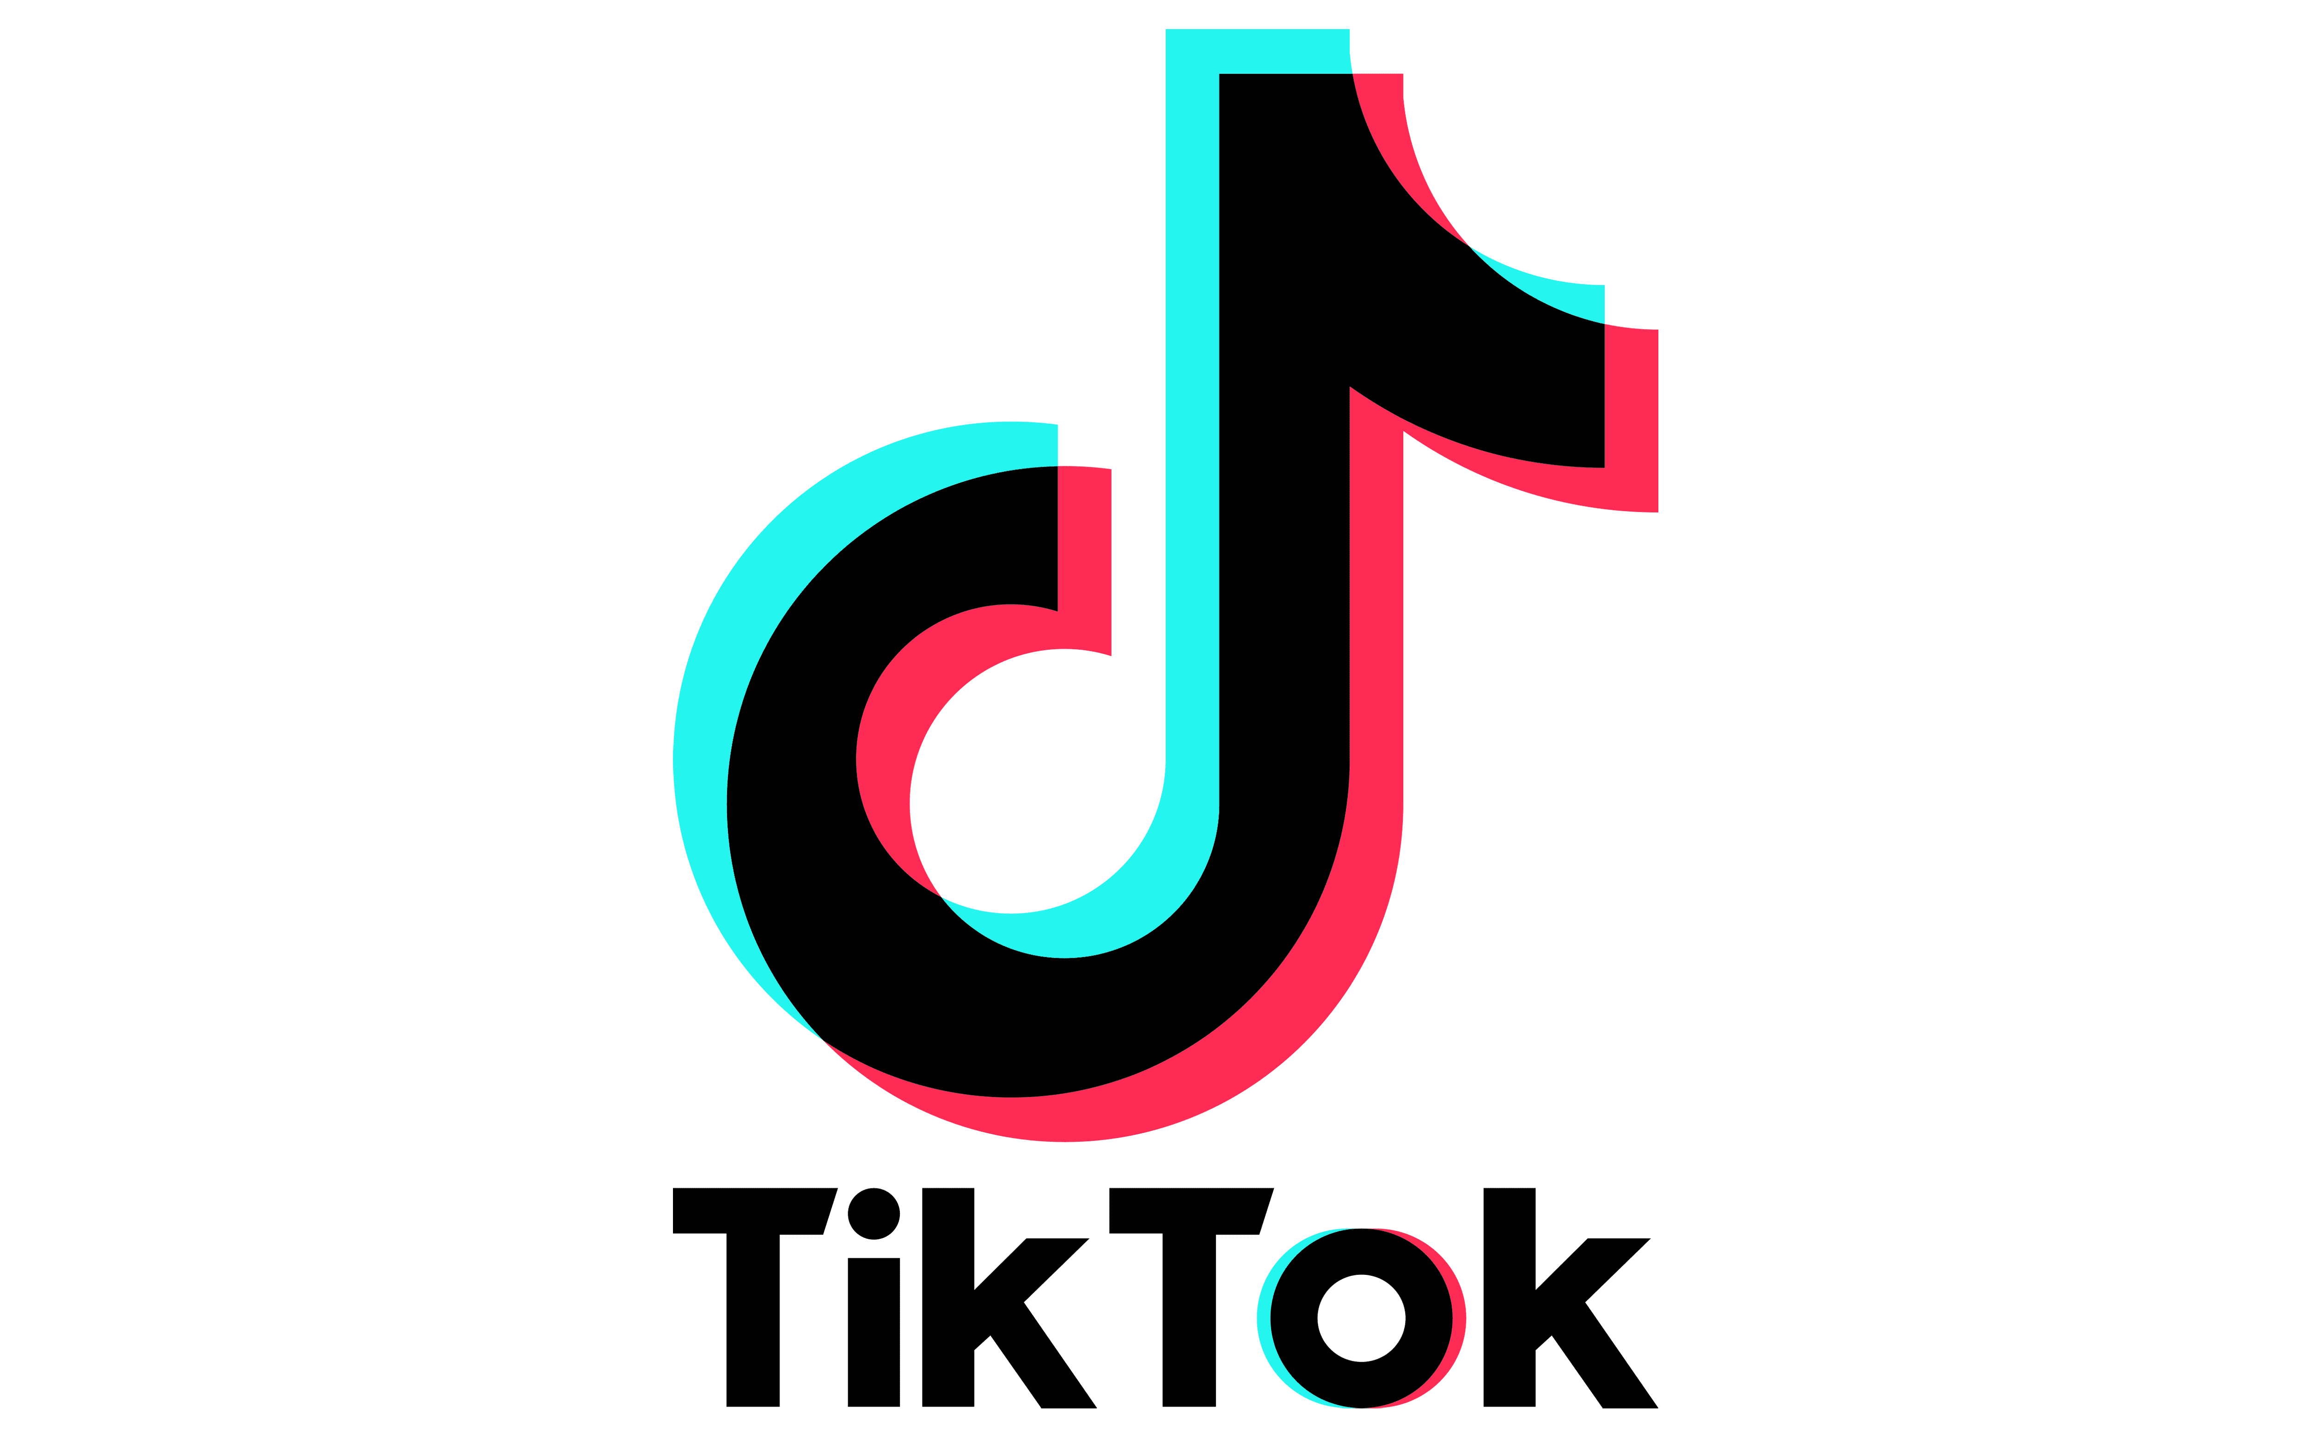
Key links
#GirlsGetEqual #IDG2023 #DayOfTheGirl #InternationalDayOfTheGirl
Links
New State of the World's Girls' research report “Turning the world around: Girl and young women activists leading the fight for equality”: https://plan-international.org/publications/turning-world-around/
Campaign resources: Trello board (http://bit.ly/idg-2023)
Use the campaign hashtag: #GirlsGetEqual
Follow us!
Stay in touch!
Visit our website: plan-international.org
Contact us: Zoe.Birchall@Plan-international.org
@planglobal
@planinternational
planinternational
planinternational
plan-international
@plan.international

Slide 7
About…
The Girls Get Equal campaign
Plan International has been campaigning for girls’ rights for over a decade. The Girls Get Equal campaign, created with youth activists around the world, aims to ensure girls and young women have equal power over their own lives and can shape the world around them. Girls and young women, in all their diversity, must be free to be themselves: to campaign, take collective action, and make decisions about the issues that affect their lives, wherever they are.

